Slide 1

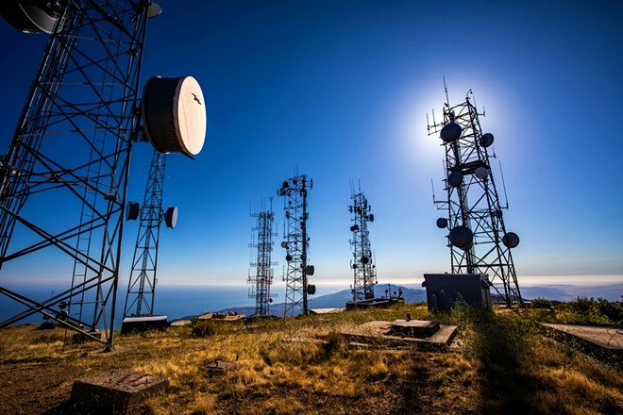
CUSTOMER CHURN PREDICTION

Slide 2

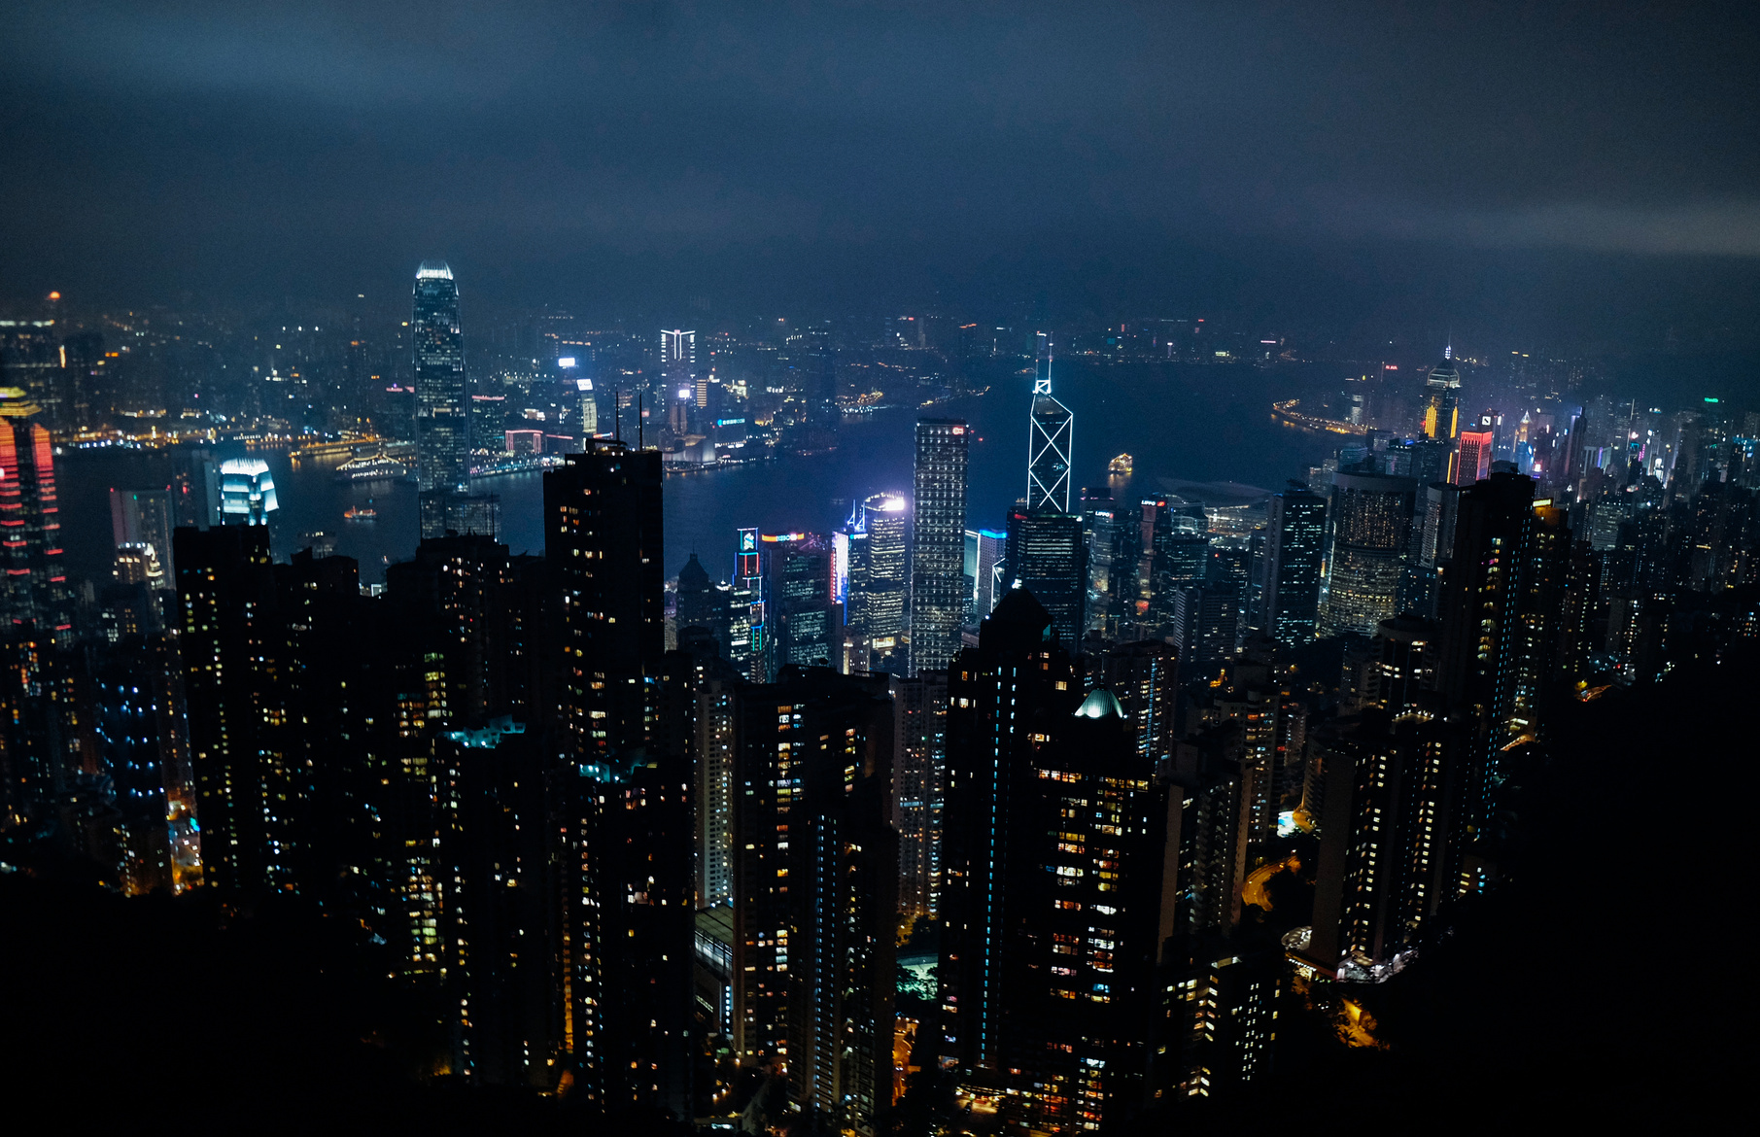

Agenda
01
02
03
04
05
06
Introduction
Data Exploration
Data Preprocessing
Data Modeling and Results
Limitation and Recommendations
Conclusion

Slide 3
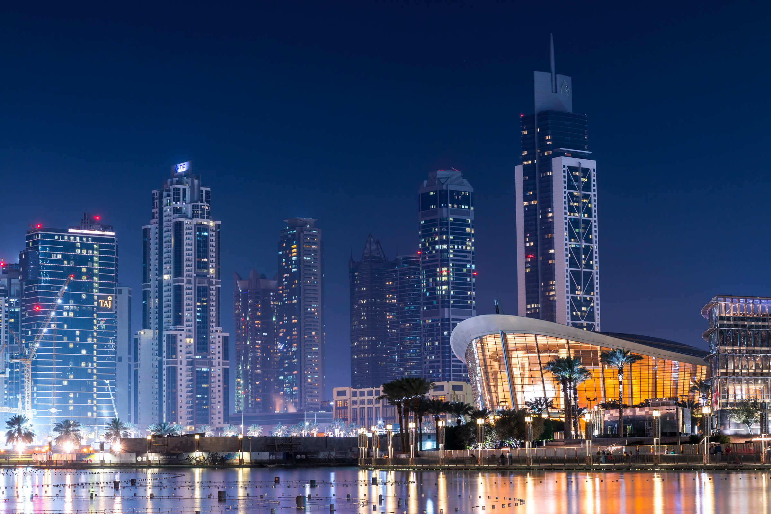
INTRODUCTION
BML: BML Group is a major player in the global telecom market, with a strong presence in Africa and a robust footprint in mobile, internet and emerging technologies.
Churn is a problem for telecom companies because it is more expensive to acquire a new customer than to keep your existing one from leaving.
Churn prediction is one of the most popular Big Data use cases in business. It consists of detecting customers who are likely to cancel a subscription to a service.

Slide 4
PROJECT OBJECTIVE
To predict overall Customer Churn.
Highlighting the main variables/factors influencing Customer Churn.
Use various ML algorithms to build prediction models, evaluate the accuracy and performance of these models.
Finding out the best model for our business case & providing executive summary.

Slide 5
DATA EXPLORATION
Originally the dataset contained 7043 rows and 21 columns.
Adjusted Dataset Shape: After dropping customer ID and handling missing values in Total Charges, we refined the dataset to 7032 rows and 20 columns.
Output Variable Distribution: Notable skew in the output variable churn, with a class imbalance of 73.4% non-churning and 26.6% churning customers.

Slide 6
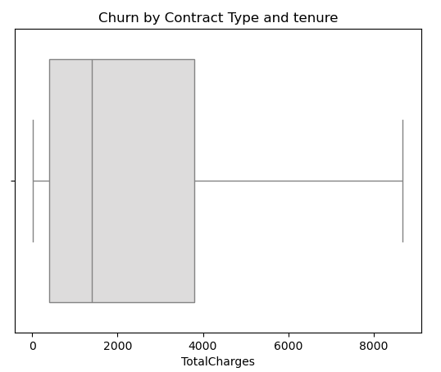
DATA EXPLORATION

Slide 7
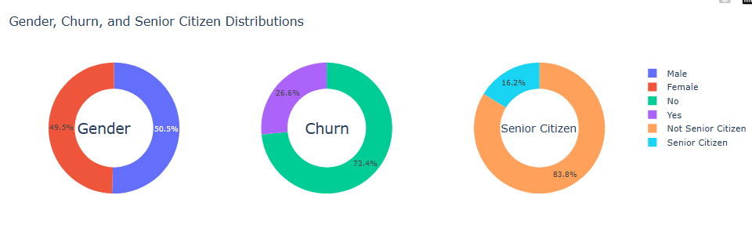
DATA EXPLORATION

Slide 8
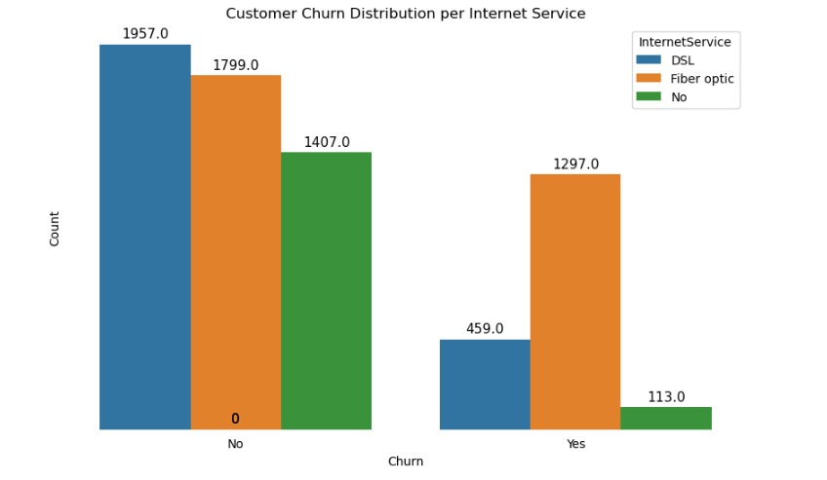
DATA EXPLORATION

Slide 9
DATA PREPROCESSING
The best option for the skewed distributions was the RobustScaler.
The application of LabelEncoder was to change the categorical variables to numerical form to aid with the functioning of the machine learning model
Test data used was 20%, reserving the remaining 80% for training of the model
Selected Features: Contract, Tech Support, PaymentMethod, SeniorCitizen, InternetService and TotalCharges

Slide 10
MACHINE LEARNING ALGORITHMS
KNN (K-Nearest Neighbors)
SVC( Support Vector Classifier)
Logistic Regression
Decision Tree Classifier
Random Forest Classifier
Voting Classifier

Slide 11
COMPARING THE MODELS
Model | Accuracy | Precision | F1-Score | Recall
KNN (K-Nearest Neighbor) | 77.97% | 43.58% | 51.26% | 62.21%
SVC( Support Vector Classifier) | 78.68% | 45.72% | 53.27% | 63.80%
Logistic Regression | 79.10% | 63.99% | 55.45% | 48.93%
Decision Tree Classifier | 73.13% | 48.93% | 49.19% | 49.46%
Random Forest Classifier | 72.42% | 45.99% | 46.99% | 48.04%
Voting Classifier | 77.04% | 44.92% | 50.99% | 58.95%

Slide 12
RESULTS
Model Selection:
Based on the evaluation metrics, the best-performing model is selected. The chosen model offers a moderate accuracy, precision, F1-score and recall.
The selected model( Logistic Regression with F1-score of 55.45%) provides valuable insights into the factors contributing to customer churn and can be used to predict churn with moderate accuracy.

Slide 13
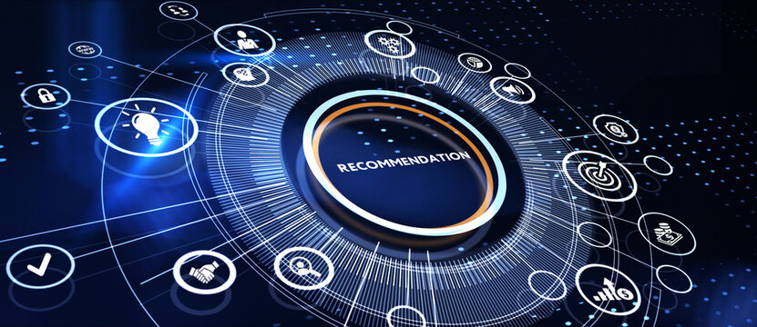
RECOMMENDATIONS
Promote Long-Term Contracts: Encourage yearly contracts with incentives to improve customer retention.
Enhance Customer Support: Improve satisfaction with proactive and personalized support.
Offer Bundles: Bundle services to add value and increase loyalty. Flexible Payment Options: Offer a range of payment methods and encourage stable option
LIMITATIONS
This dataset did not go through hyperparameter tuning and smoothing, and scores are lower than expected.

Slide 14

CONCLSUION
At BML we have carried our own water, and learnt to value every drop.

Slide 15
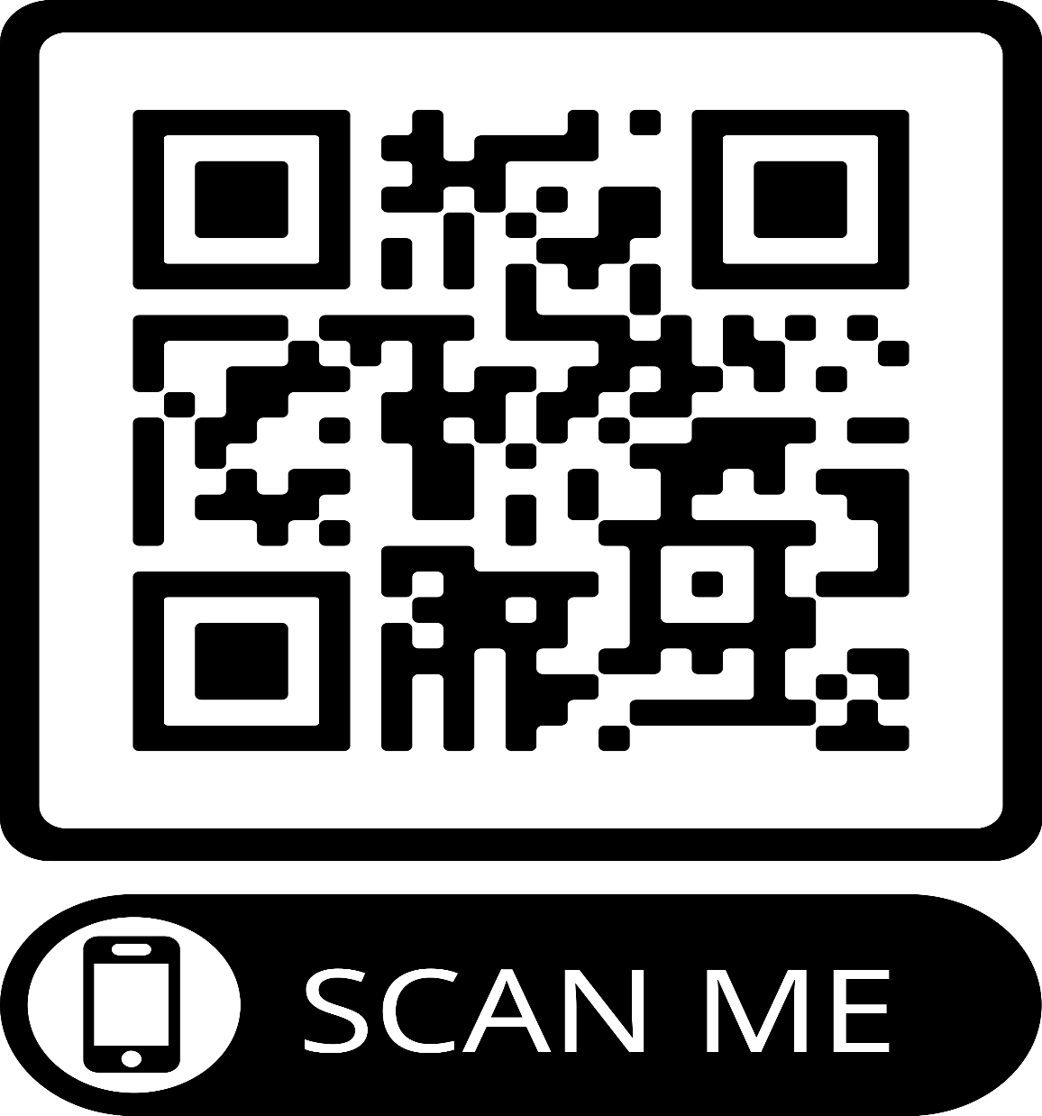

GOING LIVE
https://telcocustomerchurn--bml.streamlit.app/

Slide 16


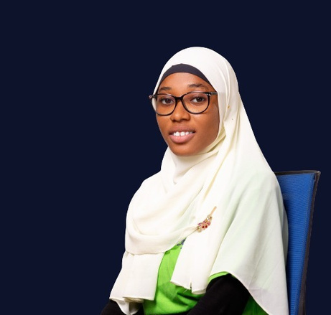
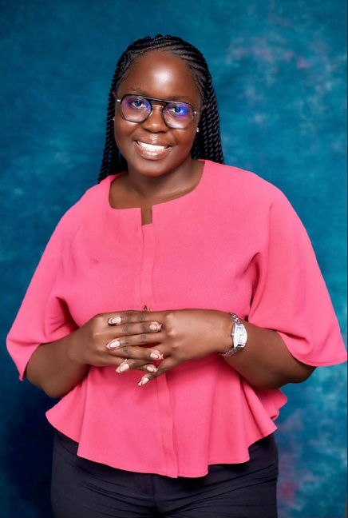
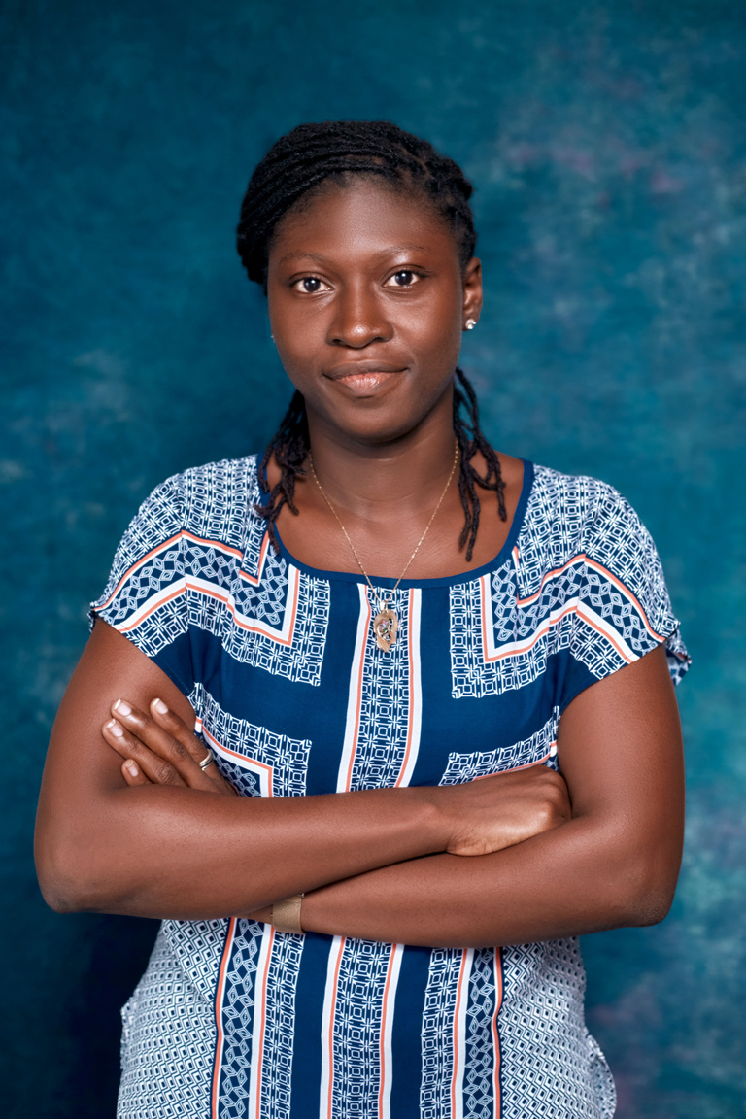
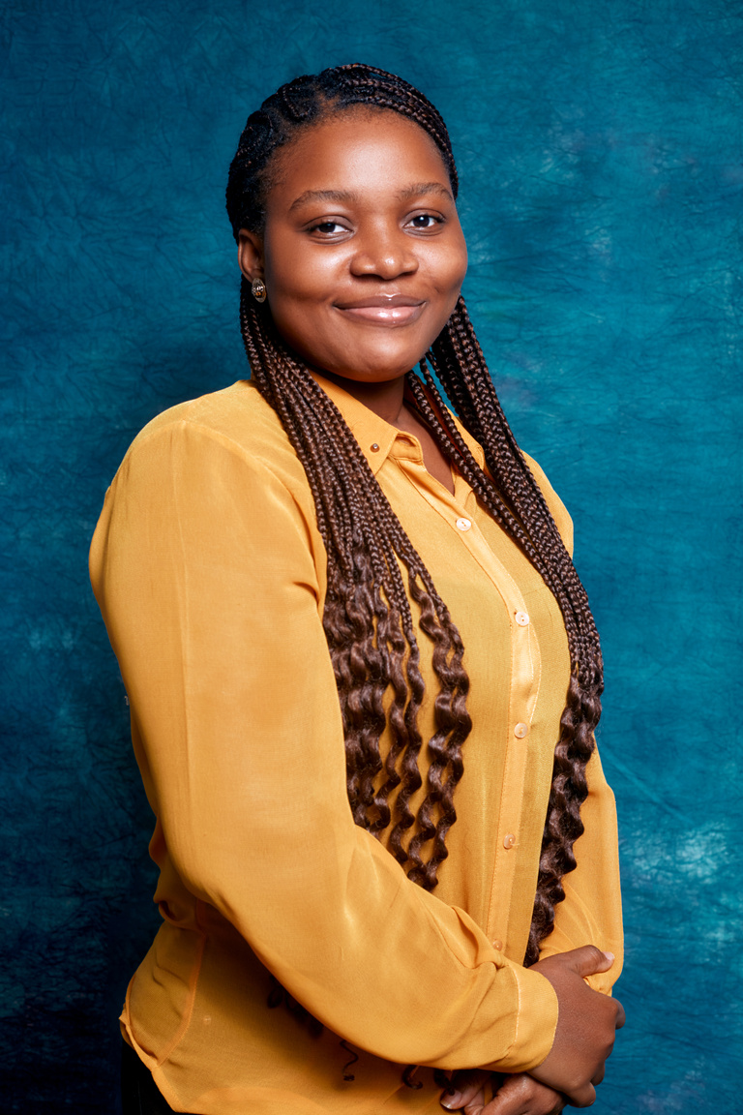
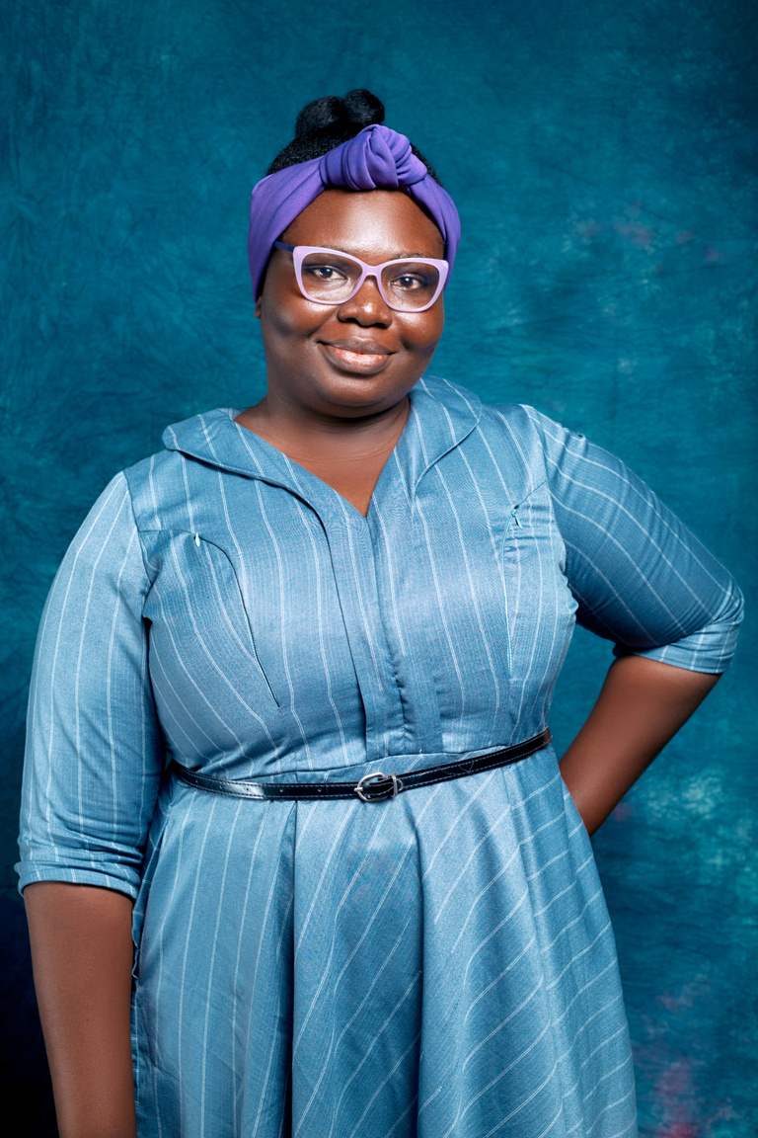

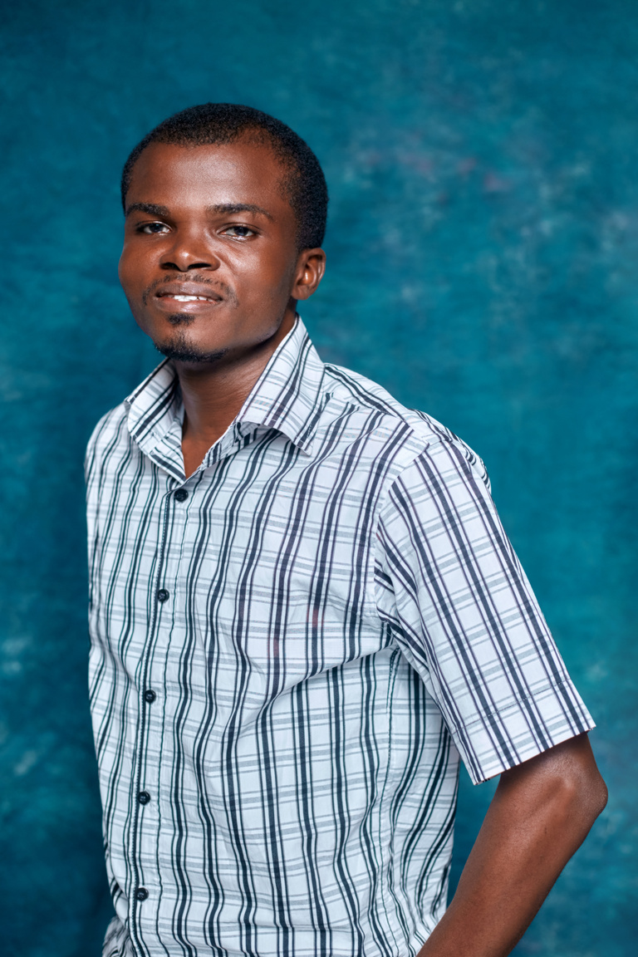

Our Team
Halimatu Saadia Issah
Nana Aisha Hussein
Nana Y. Adjeiwaa Poku
Adelaide Odametey
Hannah Mensah
Nuamah Siaw Jeffrey
Michael Kofi Teye

Slide 17

Thank You!

